Slide 1


Ocean Bitemap: global and local drivers of shallow water predation intensity
Matt Whalen, Ross Whippo, 40+ authors, Emmett Duffy
O’Connor Lab Meeting

Slide 2
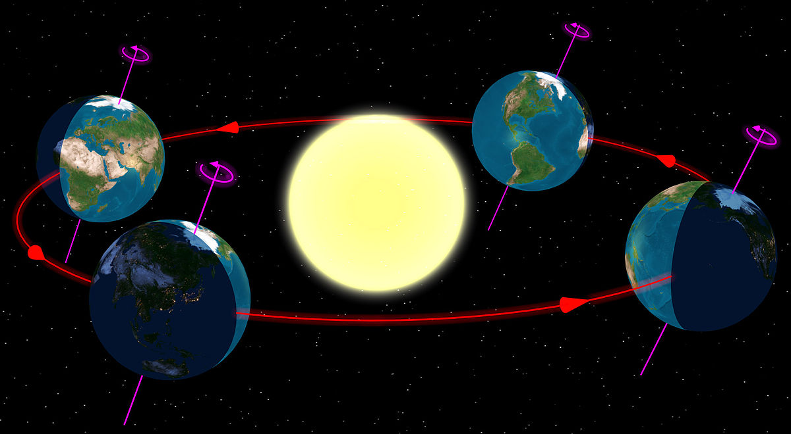
Latitudinal gradients:
among the most studied and celebrated patterns in ecology
Ultimately driven by the Earth’s rotation and orbit around the sun, hence global scale
Classic gradients:
light and temperature
productivity
species diversity
interaction strength
Productivity
Diversity
Interactions

Slide 3
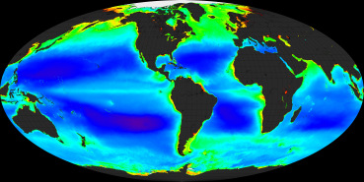
We can see primary production from space
Maps of phytoplankton and terrestrial plants help us understand what constrains primary productivity at global and regional levels
Where does this production go? Do we understand how species interactions funnel energy and materials up food webs?

Slide 4
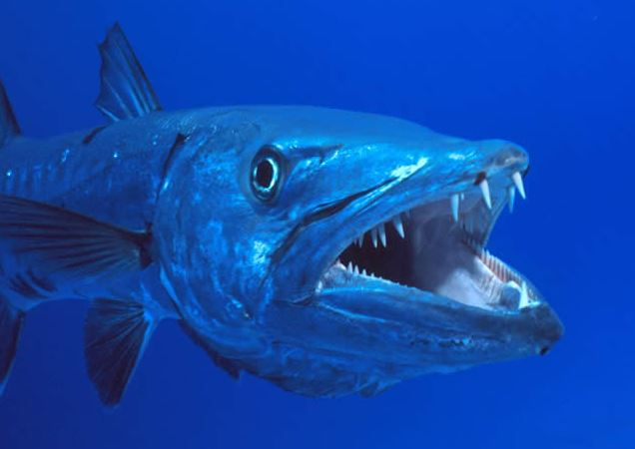
Bitemap: a globally resolved map of predation intensity using standardized methods
Consumption is what moves energy and materials through food webs, so measuring consumption across space will tell us about trophic transfer
Predation, fisheries production
Abiotic gradients
Primary production

Slide 5
Bitemap: what should it look like?
Perhaps predation rates should mirror patterns of fish abundance and diversity
Predation likely influenced directly by temperature as consumption is a temperature-dependent process
Hypothesis: monotonic increase in predation pressure with decreasing latitude / mean temperature
Edgar et al 2017 Sci Adv

Slide 6
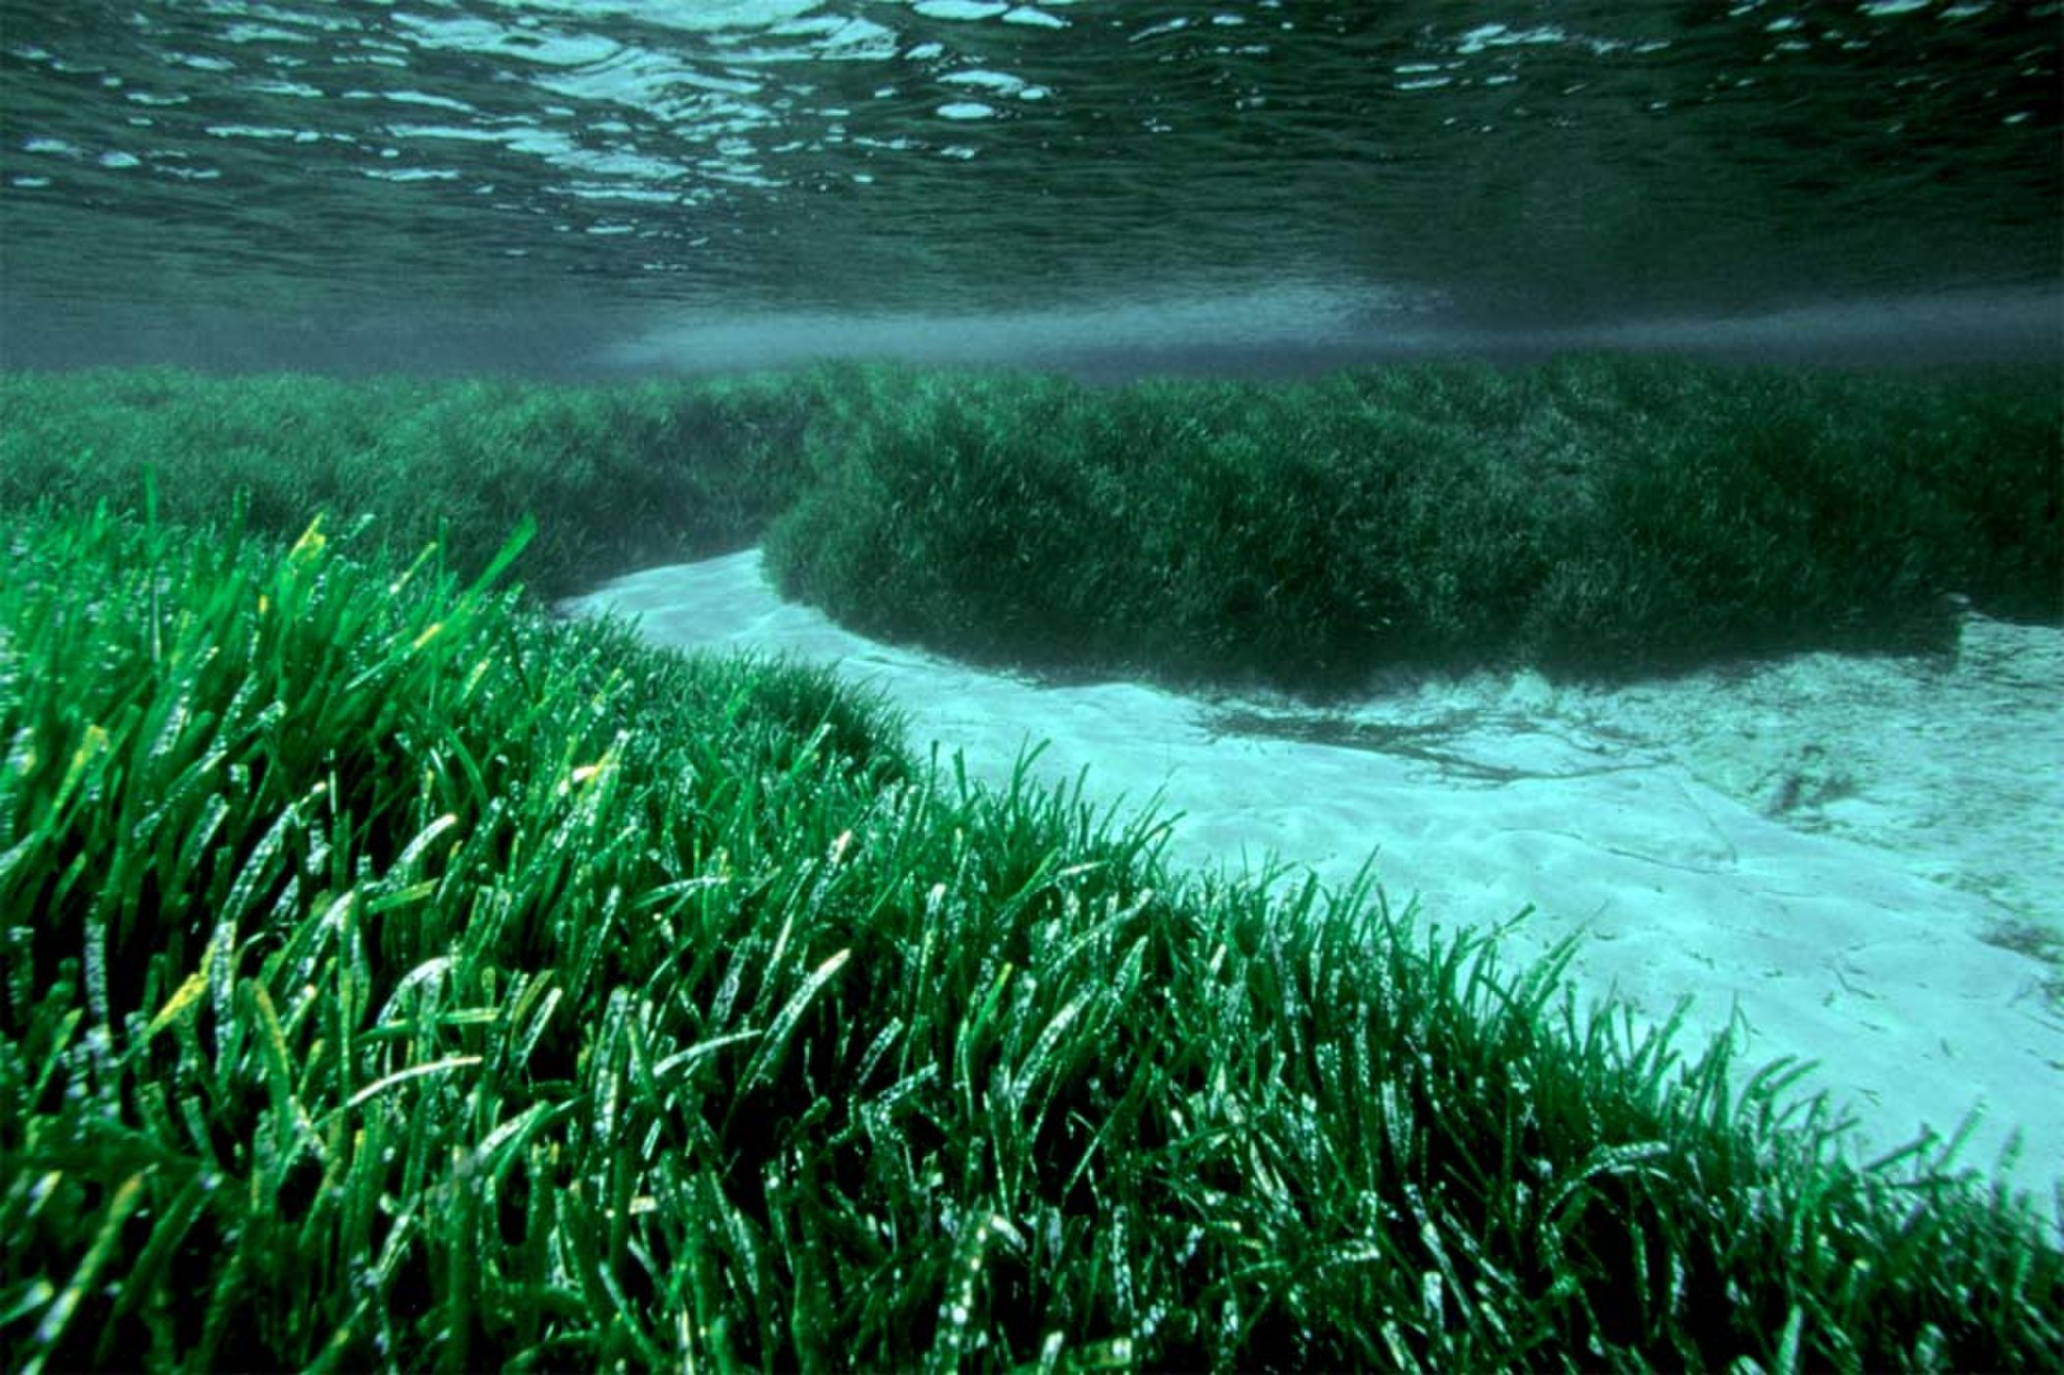

Bitemap: what should it look like? Influence of physical structure?
Effect of physical structure on predation can be difficult to predict.
Predation can be lower or higher in vegetated habitats like seagrasses, but this is complicated by a number of factors:
density of vegetation
predator/prey composition
body size + other functional traits of predators and prey
M San Felix

Slide 7
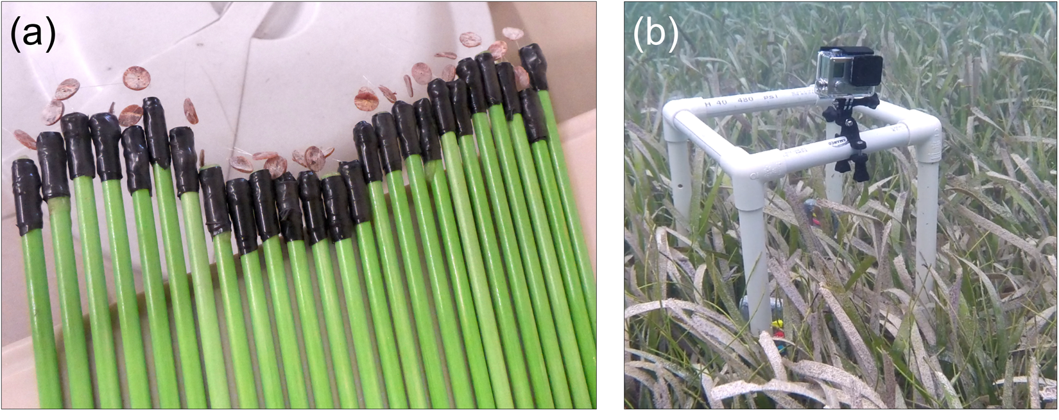
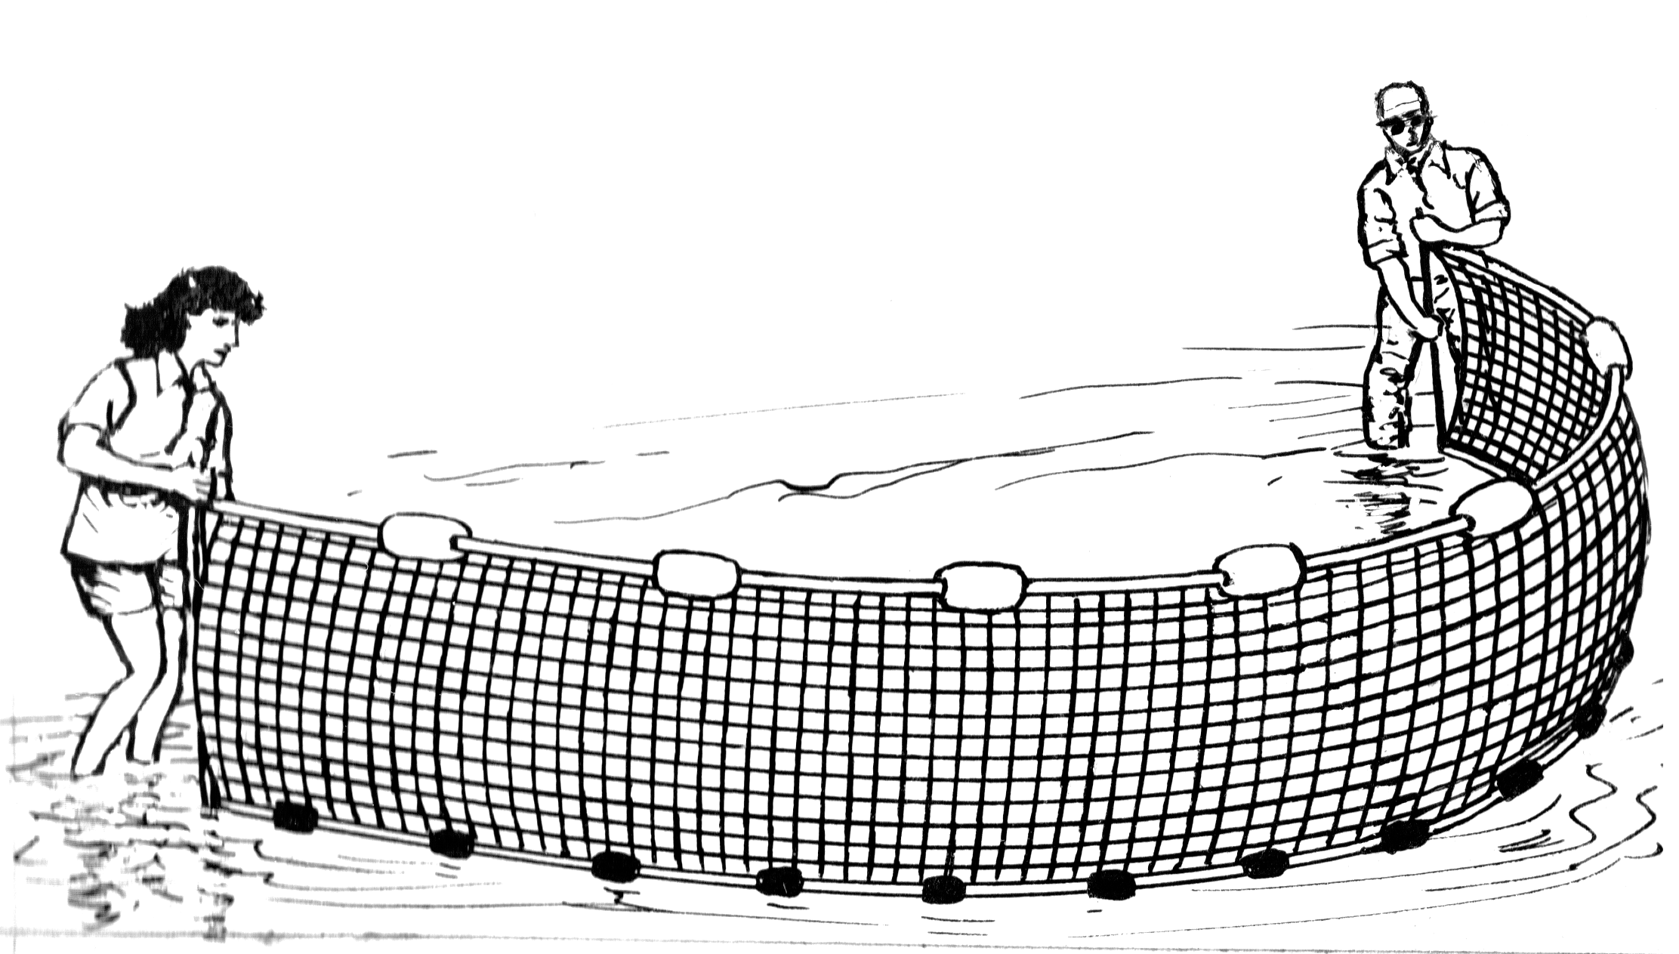
Methods: Squidpops + Predator surveys
Squidpops
25 squidpops each in seagrass and unvegetated habitats
repeated three times
presence/absence of squid measured at 1 and 24 hours
exponential decay of squidpops over time as predation rate
GLMMs on rates (logit link)
Predator surveys
coupled seining and/or video
predator abundance, biomass, diversity FROM SEINES
use traits to select taxa
Duffy et al 2015 PLoS ONE

Slide 8
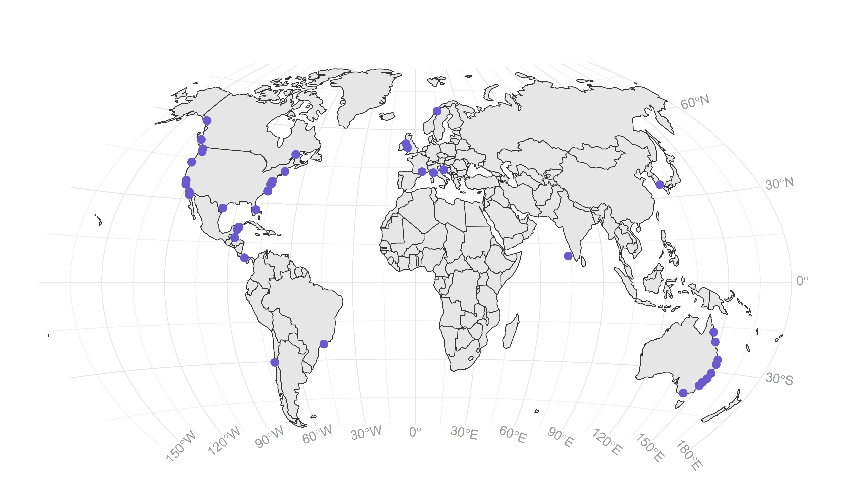
Bitemap: 2016 and 2017 efforts
40 sites across 105 degrees of latitude
seagrass vs unvegetated habitat (n=37)
strong gradients in temperature (annual mean and instantaneous)
14 species of seagrass (dominated by Zostera, 4 species max at one site)

Slide 9
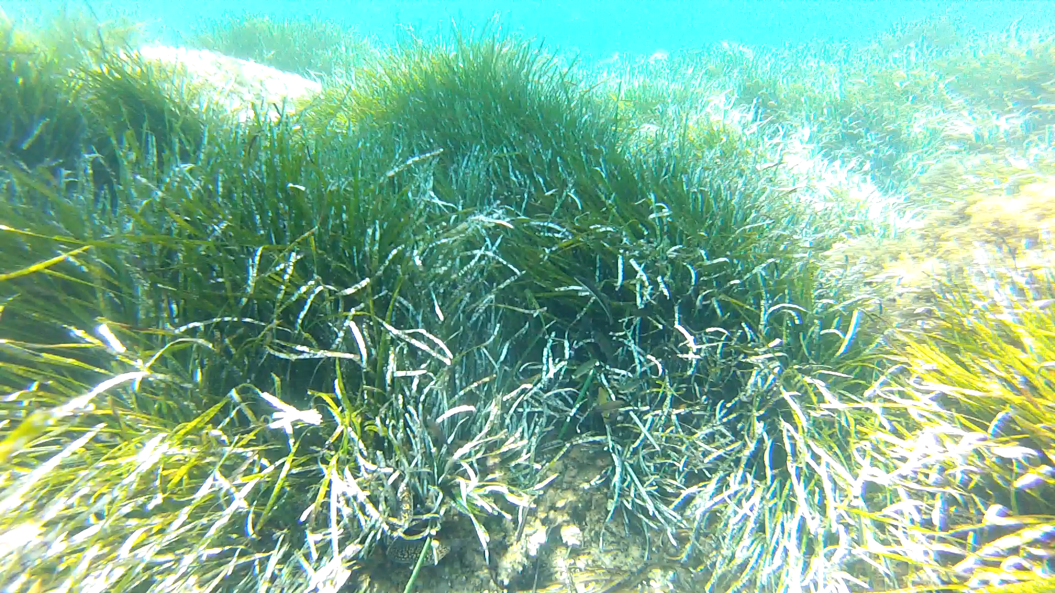
Mediterranean Posidonia bed
Lisandro Benedetti-Cecchi

Slide 10
Apparent drop in predation rate at lowest latitudes/average temps
Model comparison: AIC supports quadratric effect of mean annual SST
Modest influence of vegetation at this scale (slightly higher in seagrass, on average)

Slide 11
Fish abundance, biomass, and diversity all higher in seagrass, on average

Slide 12
Fish abundance increases with annual mean temperature
But, fish biomass declines at highest temperatures
Note: both abundance and biomass on a log scale

Slide 13
In situ (measured) temperature showed monotonic pattern
Predation rate on squidpops increases with temperature and biomass (additively)

Slide 14
In situ (measured) temperature showed monotonic pattern
Predation rate on squidpops increases with temperature and biomass (additively)

Slide 15
In situ (measured) temperature showed monotonic pattern
Predation rate on squidpops increases with temperature and biomass (additively)

Slide 16
Not a clear relationship between long-term range in SST and predation

Slide 17
Predator family-level composition largely determined by temperature
data are family presence-absence
NMDS
Stress=0.15

Slide 18
Predator family-level composition largely determined by temperature
data are family presence-absence
temperature GAM
family vectors
cold hot
cold hot

Slide 19
Species richness within families shows affiliation with temperature regimes
Families with strongest influence on composition from NMDS shown

Slide 20
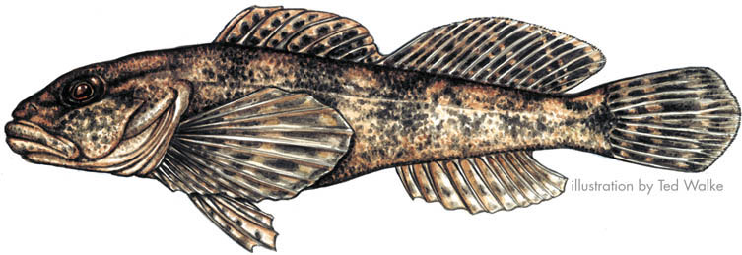
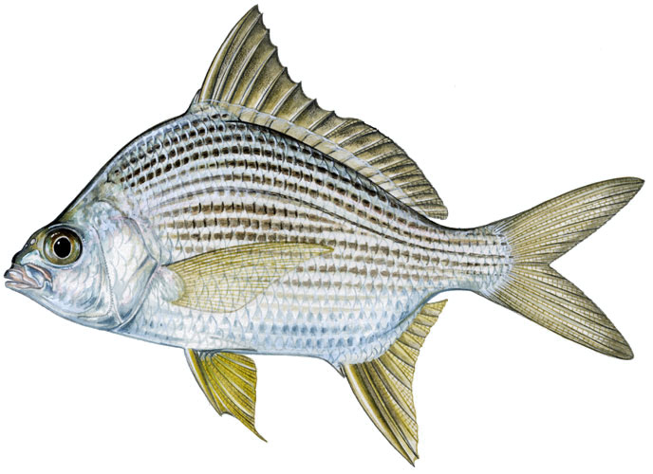
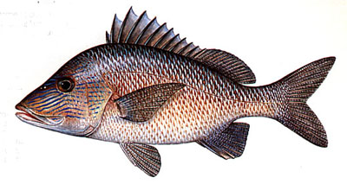
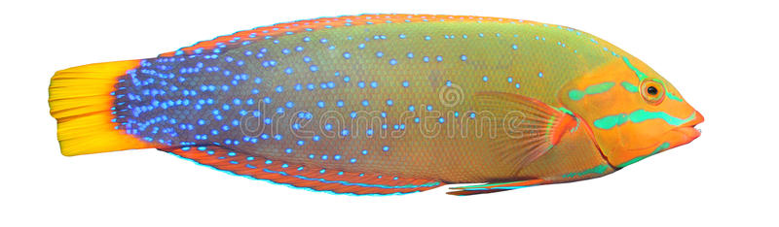
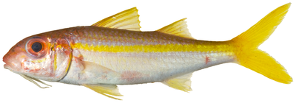
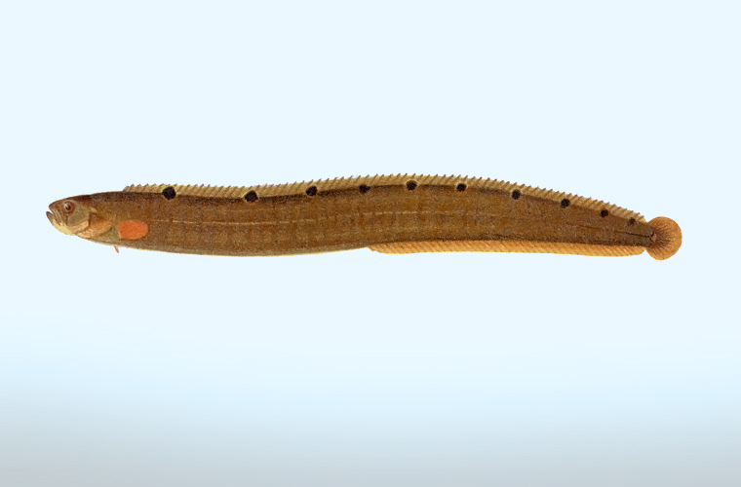
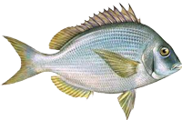
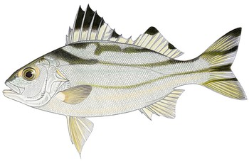
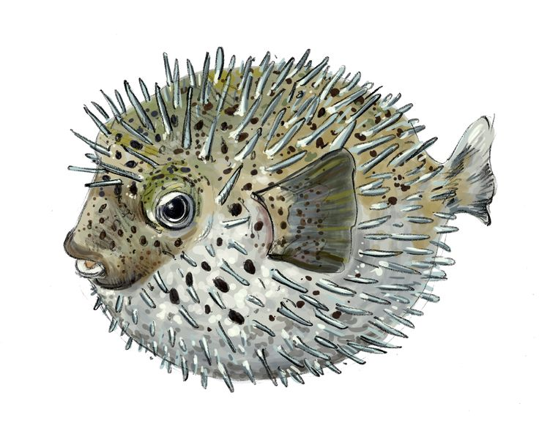
Species richness within families shows affiliation with temperature regimes
Families with strongest influence on composition from NMDS shown

Slide 21
Species richness within cold and warm families shows dip at range edges
species richness within warm families weakly related to predation rate...maybe effective numbers...

Slide 22
Conclusions
Predation rates are influenced by global-scale gradients in temperature, and hump-shaped with respect to annual means and latitude
the most tropical sites did not have the highest predation rates
Predation is influenced by local + regional ecological conditions
predation slightly higher in seagrass habitats
abundance, diversity, and biomass of predators explain habitat result
strong turnover of predator communities across thermal gradient
richness of warm water species weakly associated with peaks in predation pressure
Thermal environment and predator community independently explain global variation in predation on standardized prey

Slide 23
Models of predation rate ~ temperature + fish biomass (warm families only)

